Slide 1





SQUAD
COMP6452 Project Task2
z5414347(Yifan Hong)
z5453260(Zeyu Wang)
z5360071(Zenglin Zhong) z5503242(Frank XIONG)
z5275904(Daniel Deng)

Slide 2


Member Contribution
Frank Xiong(z5503242): Blockchain architecture and framwork part
Zenglin Zhong(z5360071): Chaincode part
Danniel Deng(z5275904): Backend part
Zeyu Wang(z5453260): Frontend
Yifan Hong(z5414347): Off-chain componet

Slide 3

Finalised architecture
Challenges:
Medical Data Sharing
Fragmented, insecure, and inefficient
Medical Supply Chain Management
Lack of transparency and traceability, security issues
Non-transparent Healthcare Service Prices
Difficulty in comparing fees, hindering universal access
Why Healthcare?
Vital for everyone’s health and safety
Issues: data fragmentation, supply chain transparency, and insurance claim inefficiencies
Notes:
The healthcare and life sciences industries face major issues such as data sharing, privacy and supply chain traceability. Blockchain applications in healthcare will become increasingly popular, especially regarding data sharing between hospitals, patients and drug manufacturers.

Slide 4

Implementation details
Functional requirements:
Non-Functional requirements:
Data Privacy Protection
Traceability and Auditability
High Availability
Scalability
Security
1. The entire life cycle of medical supplies should be tracked and recorded.
The system must track and record the entire lifecycle of medical supplies, including production, transportation, storage, and sell.
hospital purchases drugs
2. The status and location of medical supplies can be seen by those with permission, while only authorized personnel can modify this information.
patient go to the hospital for a physical examination
3. The production and sales prices of medical supplies need to be recorded and searchable to provide pricing transparency.
Drug manufacturers provide drug prices and claim details

Slide 5

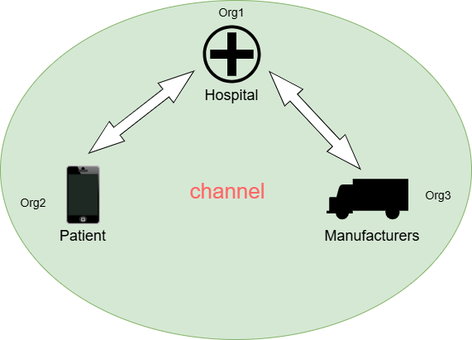
Hyperledger Fabric
Hyperledger Fabric is an enterprise-grade blockchain platform led by the Linux Foundation, focusing on privacy and permissioned access:
Permissioned Blockchain：Unlike Ethereum, Fabric is a permissioned blockchain, meaning only authorized participants can join the network.
Privacy and Confidentiality：Channels and Private Data Collections
Membership Service Provider (MSP)
Smart Contracts (Chaincode)
Modular Architecture
Scalability
Notes:
However, in practice, the business logic of how to add different nodes to the channel and the cross-channel invokes between different channels is more difficult to implement, for with us, again, or it takes time to test and debug.

Slide 6
Smart Contract

Slide 7
Backend

Slide 8
Demo

Slide 9


Thank you

